Slide 1
CS101 Algorithms and Data Structures
Quick Sort
Textbook Ch 2.7
Notes:
Adapted from the slides by Douglas Wilhelm Harder of U Waterloo (https://ece.uwaterloo.ca/~dwharder/aads/Lecture_materials/)
May also contain material from the slides at https://courses.cs.washington.edu/courses/cse326/03wi/326lecturesb.shtml (by Dan Suciu of U Wash
内容包含：
1. quick sort
2. 螺栓螺帽配对问题
3. 主定理（基础）

Slide 2
Outline
Insertion sort
Bubble sort
Merge sort
Quicksort

Slide 3
Outline
In this topic we will look at quicksort:
The idea behind the algorithm
The run time and worst-case scenario
Strategy for avoiding the worst-case: median-of-three
Implementing quicksort in place
Examples

Slide 4
Strategy
We have seen two Θ(n ln(n)) sorting algorithms:
Heap sort which allows in-place sorting, and
Merge sort which is faster but requires more memory
We will now look at a recursive algorithm which may be done almost in place but which is faster than heap sort
Use an object in the array (a pivot) to divide the two
Average case: Θ(n ln(n)) time and Θ(ln(n)) memory
Worst case: Θ(n²) time and Θ(n) memory
We will look at strategies for avoiding the worst case
Notes:
Heap 和merge 都是nlogn

Slide 5


Quicksort
Merge sort splits the array into two sub-lists and sorts them
It splits the larger problem into two sub-problems based on location in the array
Consider the following alternative:
Chose an object in the array and partition the remaining objects into two groups relative to the chosen entry
How was your holiday?
… …

Slide 6
Quicksort
For example, given
we can select the middle entry, 44, and sort the remaining entries into two groups, those less than 44 and those greater than 44:
Notice that 44 is now in the correct location if the list was sorted
Proceed by recursively applying the algorithm to the first six and last eight entries
80 | 38 | 95 | 84 | 66 | 10 | 79 | 44 | 26 | 87 | 96 | 12 | 43 | 81 | 3
38 | 10 | 26 | 12 | 43 | 3 | 44 | 80 | 95 | 84 | 66 | 79 | 87 | 96 | 81
Notes:
选了44，前面小，后面大，那么44现在在正确的位置上

Slide 7
Run-time analysis
Like merge sort, we can either:
Sort the sub-lists using quicksort
If the size of the sub-list is sufficiently small, apply insertion sort
In the best case, the list will be split into two approximately equal sub-lists, and thus, the run time could be very similar to that of merge sort: Θ(n ln(n))
What happens if we don’t get that lucky?
Notes:
如果和merge sort 一样的策略，并且前后差不多长，会得到nlogn，

Slide 8
Worst-case scenario
Suppose we choose the middle element as our pivot and we try ordering a list:
Using 2, we partition into
We still have to sort a list of size n – 1
The run time is T(n) = T(n – 1) + Θ(n) = Θ(n²)
Thus, the run time performance drops from nln(n) to n²
80 | 38 | 95 | 84 | 66 | 10 | 79 | 2 | 26 | 87 | 96 | 12 | 43 | 81 | 3
2 | 80 | 38 | 95 | 84 | 66 | 10 | 79 | 26 | 87 | 96 | 12 | 43 | 81 | 3
Notes:
Worst case：每一次都选最小的做pivot，复杂度n方

Slide 9
Worst-case scenario
Our goal is to choose the median element in the list as our pivot:
Using the median element 66, we can get two equal-size sub-lists
Unfortunately, median is difficult to find
80 | 38 | 95 | 84 | 66 | 10 | 79 | 2 | 26 | 87 | 96 | 12 | 43 | 81 | 3
3 | 38 | 43 | 12 | 2 | 10 | 26 | 66 | 79 | 87 | 96 | 84 | 95 | 81 | 80
Notes:
最好就是每次选中位数

Slide 10
BST representation
The original array of elements A
a7 | a6 | a12 | a3 | a11 | a8 | a9 | a1 | a4 | a10 | a2 | a13 | a5
first pivot
(chosen uniformly at random)
first pivot in
left subarray
a9
a3
a11
a1
a8
a10
a13
a2
a4
a12
a6
a5
a7

Slide 11
BST representation
Proposition. The expected number of compares to quicksort an array of n distinct elements a1 < a2 < ⋯ < an is O(n log n).
Pf. Consider BST representation of pivot elements.
ai and aj are compared once if one is an ancestor of the other.
first pivot
(chosen uniformly at random)
a3 and a6 are compared (when a3 is pivot)
first pivot in
left subarray
a9
a3
a11
a1
a8
a10
a13
a2
a4
a12
a6
a5
a7

Slide 12
Analysis of running time
Proposition. The expected number of compares to quicksort an array of n distinct elements a1 < a2 < ⋯ < an is O(n log n).
Pf. Consider BST representation of pivot elements.
ai and aj are compared once if one is an ancestor of the other.
first pivot
(chosen uniformly at random)
a3 and a6 are compared (when a3 is pivot)
first pivot in
left subarray
a9
a3
a11
a1
a8
a10
a13
a2
a4
a12
a6
a5
a7

Slide 13
Question 1
Given an array of n ≥ 8 distinct elements a1 < a2 < ⋯ < an, what is the probability that a7 and a8 are compared during randomized quicksort?
A. 0
B. 1 / n
C. 2 / n
D. 1
if two elements are adjacent,
one must be an ancestor of the other
a9
a3
a11
a1
a8
a10
a13
a2
a4
a12
a6
a5
a7

Slide 14
Question 2
Given an array of n ≥ 8 distinct elements a1 < a2 < ⋯ < an, what is the probability that a1 and a_{n} are compared during randomized quicksort?
A. 0
B. 1 / n
C. 2 / n
D. 1
a1 and an are compared
if first pivot is either a1 or an
a9
a3
a11
a1
a8
a10
a13
a2
a4
a12
a6
a5
a7

Slide 15
Analysis of running time
Proposition. The expected number of compares to quicksort an array of n distinct elements a1 < a2 < ⋯ < an is O(n log n).
Pf. Consider BST representation of pivot elements.
ai and aj are compared once if one is an ancestor of the other.
Pr [ ai and aj are compared ] = 2 / ( j − i + 1), where i < j.
Pr[a2 and a8 compared] = 2/7
compared if either a2 or a8 is chosen as pivot before any of { a3, a4, a5, a6, a7}
a9
a3
a11
a1
a8
a10
a13
a2
a4
a12
a6
a5
a7

Slide 16
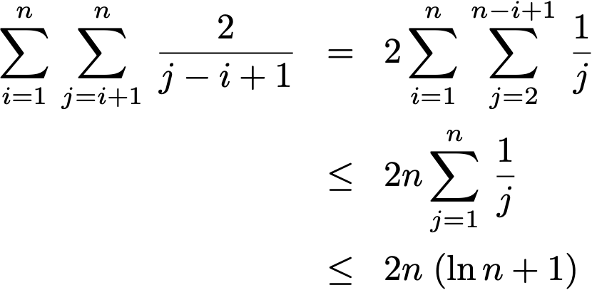
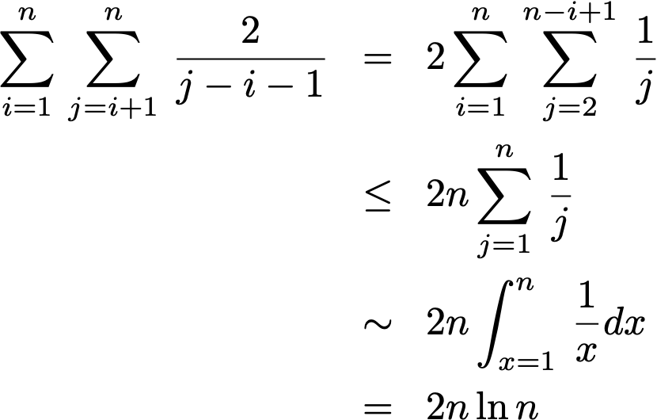
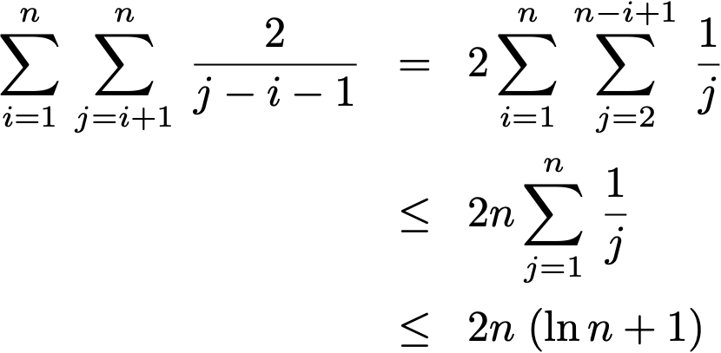
Analysis of running time
Proposition. The expected number of compares to quicksort an array of n distinct elements a1 < a2 < ⋯ < an is O(n log n).
Pf. Consider BST representation of pivot elements.
ai and aj are compared once if one is an ancestor of the other.
Pr [ ai and aj are compared ] = 2 / ( j − i + 1), where i < j.
Expected number of compares =
all pairs i and j
harmonic sum

Slide 17
Median-of-three
Consider another strategy:
Choose the median of the first, middle, and last entries in the list
This will usually give a better approximation of the actual median
Notes:
为了坑小，选三个位置的中位数

Slide 18
Median-of-three
Sorting the elements based on 44 results in two sub-lists, each of which must be sorted (again, using quicksort)
Select the 26 to partition the first sub-list:
Select 81 to partition the second sub-list:

Slide 19
Median-of-three
If we choose a random pivot, this will, on average, divide a set of n items into two sets of size 1/4 n and 3/4 n, why?
Choosing the median-of-three, this will, on average, divide the n items into two sets of size 5/16 n and 11/16 n
Median-of-three helps speed the algorithm
This requires order statistics:
Notes:
We ½ to choose the first half nodes and then on avg we will separate the half into anther half, the same separation happens if we choose one item from the second half.

Slide 20
Median-of-three
Recall that merge sort always divides a list into two equal halves:
The median-of-three will require or 85 % more recursive steps, how to get this?
A single random pivot will require or 141 % more recursive steps

Slide 21
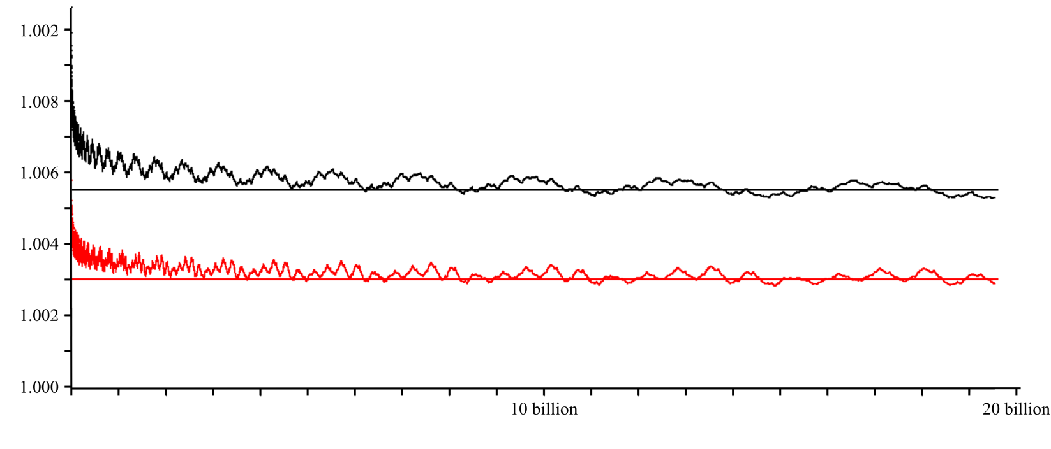
Median-of-three
Question: what is the affect on run time?
Surprisingly, not so much
Here we see the ratios of the recurrence relations for large values of n

Slide 22
Implementation
If we choose to allocate memory for an additional array, we can implement the partitioning by
copying elements either to the front or the back of the additional array
placing the pivot into the resulting hole

Slide 23
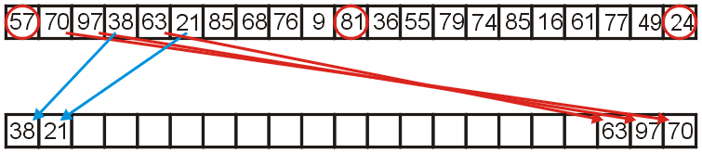
Implementation
For example, consider the following:
57 is the median-of-three
we go through the remaining elements, assigning them either to the front or the back of the second array

Slide 24
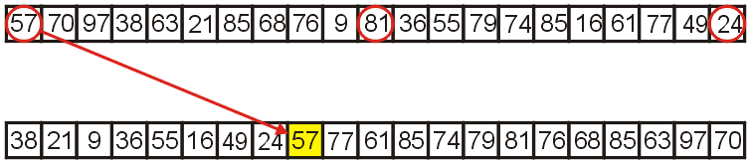
Implementation
Once we are finished, we copy the median-of-three, 57, into the resulting hole

Slide 25
Implementation
Can we implement quicksort in place?
Yes!
Swap the pivot to the last slot of the list
We repeatedly try to find two entries:
Staring from the front: an entry larger than the pivot
Starting from the back: an entry smaller than the pivot
Such two entries are out of order, so we swap them
Repeat until all the entries are in order
Move the leftmost entry larger than the pivot into the last slot of the list and fill the hole with the pivot

Slide 26
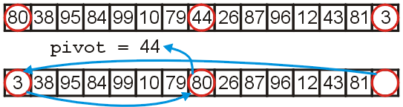
Implementation
First, we have already examined the first, middle, and last entries and chosen the median of these to be the pivot
In addition, we can:
move the smallest entry to the first entry
move the largest entry to the middle entry

Slide 27
Implementation
The implementation is straight-forward
template <typename Type>
void quicksort( Type *array, int first, int last ) {
if ( last - first <= N ) {
insertion_sort( array, first, last );
} else {
Type pivot = find_pivot( array, first, last );
int low = find_next( pivot, array, first + 1 );
int high = find_previous( pivot, array, last - 2 );
while ( low < high ) {
std::swap( array[low], array[high] );
low = find_next( pivot, array, low + 1 );
high = find_previous( pivot, array, high - 1 );
}
array[last – 1] = array[low];
array[low] = pivot;
quicksort( array, first, low );
quicksort( array, high, last );
}
}

Slide 28
Quicksort example
Consider the following unsorted array of 25 entries
We will call insertion sort if the list being sorted of size N = 6 or less
0 | 1 | 2 | 3 | 4 | 5 | 6 | 7 | 8 | 9 | 10 | 11 | 12 | 13 | 14 | 15 | 16 | 17 | 18 | 19 | 20 | 21 | 22 | 23 | 24
13 | 77 | 49 | 35 | 61 | 48 | 73 | 23 | 95 | 3 | 89 | 37 | 57 | 99 | 17 | 32 | 94 | 28 | 15 | 55 | 7 | 51 | 88 | 97 | 62
Sorting again, my friend.

Slide 29
Quicksort example
We call quicksort( array, 0, 25 )
0 | 1 | 2 | 3 | 4 | 5 | 6 | 7 | 8 | 9 | 10 | 11 | 12 | 13 | 14 | 15 | 16 | 17 | 18 | 19 | 20 | 21 | 22 | 23 | 24
13 | 77 | 49 | 35 | 61 | 48 | 73 | 23 | 95 | 3 | 89 | 37 | 57 | 99 | 17 | 32 | 94 | 28 | 15 | 55 | 7 | 51 | 88 | 97 | 62
quicksort( array, 0, 25 )

Slide 30
Quicksort example
We are calling quicksort( array, 0, 25 )
First, 25 – 0 > 6, so find the midpoint and the pivot
midpoint = (0 + 25)/2; // == 12
0 | 1 | 2 | 3 | 4 | 5 | 6 | 7 | 8 | 9 | 10 | 11 | 12 | 13 | 14 | 15 | 16 | 17 | 18 | 19 | 20 | 21 | 22 | 23 | 24
13 | 77 | 49 | 35 | 61 | 48 | 73 | 23 | 95 | 3 | 89 | 37 | 57 | 99 | 17 | 32 | 94 | 28 | 15 | 55 | 7 | 51 | 88 | 97 | 62
quicksort( array, 0, 25 )

Slide 31
Quicksort example
We are calling quicksort( array, 0, 25 )
First, 25 – 0 > 6, so find the midpoint and the pivot
midpoint = (0 + 25)/2; // == 12
pivot = 57;
0 | 1 | 2 | 3 | 4 | 5 | 6 | 7 | 8 | 9 | 10 | 11 | 12 | 13 | 14 | 15 | 16 | 17 | 18 | 19 | 20 | 21 | 22 | 23 | 24
13 | 77 | 49 | 35 | 61 | 48 | 73 | 23 | 95 | 3 | 89 | 37 | 62 | 99 | 17 | 32 | 94 | 28 | 15 | 55 | 7 | 51 | 88 | 97
quicksort( array, 0, 25 )

Slide 32
Quicksort example
We are calling quicksort( array, 0, 25 )
Starting from the front and back:
Find the next element greater than the pivot
The last element less than the pivot
0 | 1 | 2 | 3 | 4 | 5 | 6 | 7 | 8 | 9 | 10 | 11 | 12 | 13 | 14 | 15 | 16 | 17 | 18 | 19 | 20 | 21 | 22 | 23 | 24
13 | 77 | 49 | 35 | 61 | 48 | 73 | 23 | 95 | 3 | 89 | 37 | 62 | 99 | 17 | 32 | 94 | 28 | 15 | 55 | 7 | 51 | 88 | 97
pivot = 57;
quicksort( array, 0, 25 )

Slide 33
Quicksort example
We are calling quicksort( array, 0, 25 )
Searching forward and backward:
low = 1;
high = 21;
0 | 1 | 2 | 3 | 4 | 5 | 6 | 7 | 8 | 9 | 10 | 11 | 12 | 13 | 14 | 15 | 16 | 17 | 18 | 19 | 20 | 21 | 22 | 23 | 24
13 | 77 | 49 | 35 | 61 | 48 | 73 | 23 | 95 | 3 | 89 | 37 | 62 | 99 | 17 | 32 | 94 | 28 | 15 | 55 | 7 | 51 | 88 | 97
pivot = 57;
quicksort( array, 0, 25 )

Slide 34
Quicksort example
We are calling quicksort( array, 0, 25 )
Searching forward and backward:
low = 1;
high = 21;
Swap them
0 | 1 | 2 | 3 | 4 | 5 | 6 | 7 | 8 | 9 | 10 | 11 | 12 | 13 | 14 | 15 | 16 | 17 | 18 | 19 | 20 | 21 | 22 | 23 | 24
13 | 51 | 49 | 35 | 61 | 48 | 73 | 23 | 95 | 3 | 89 | 37 | 62 | 99 | 17 | 32 | 94 | 28 | 15 | 55 | 7 | 77 | 88 | 97
pivot = 57;
quicksort( array, 0, 25 )

Slide 35
Quicksort example
We are calling quicksort( array, 0, 25 )
Continue searching
low = 4;
high = 20;
0 | 1 | 2 | 3 | 4 | 5 | 6 | 7 | 8 | 9 | 10 | 11 | 12 | 13 | 14 | 15 | 16 | 17 | 18 | 19 | 20 | 21 | 22 | 23 | 24
13 | 51 | 49 | 35 | 61 | 48 | 73 | 23 | 95 | 3 | 89 | 37 | 62 | 99 | 17 | 32 | 94 | 28 | 15 | 55 | 7 | 77 | 88 | 97
pivot = 57;
quicksort( array, 0, 25 )

Slide 36
Quicksort example
We are calling quicksort( array, 0, 25 )
Continue searching
low = 4;
high = 20;
Swap them
0 | 1 | 2 | 3 | 4 | 5 | 6 | 7 | 8 | 9 | 10 | 11 | 12 | 13 | 14 | 15 | 16 | 17 | 18 | 19 | 20 | 21 | 22 | 23 | 24
13 | 51 | 49 | 35 | 7 | 48 | 73 | 23 | 95 | 3 | 89 | 37 | 62 | 99 | 17 | 32 | 94 | 28 | 15 | 55 | 61 | 77 | 88 | 97
pivot = 57;
quicksort( array, 0, 25 )

Slide 37
Quicksort example
We are calling quicksort( array, 0, 25 )
Continue searching
low = 6;
high = 19;
0 | 1 | 2 | 3 | 4 | 5 | 6 | 7 | 8 | 9 | 10 | 11 | 12 | 13 | 14 | 15 | 16 | 17 | 18 | 19 | 20 | 21 | 22 | 23 | 24
13 | 51 | 49 | 35 | 7 | 48 | 73 | 23 | 95 | 3 | 89 | 37 | 62 | 99 | 17 | 32 | 94 | 28 | 15 | 55 | 61 | 77 | 88 | 97
pivot = 57;
quicksort( array, 0, 25 )

Slide 38
Quicksort example
We are calling quicksort( array, 0, 25 )
Continue searching
low = 6;
high = 19;
Swap them
0 | 1 | 2 | 3 | 4 | 5 | 6 | 7 | 8 | 9 | 10 | 11 | 12 | 13 | 14 | 15 | 16 | 17 | 18 | 19 | 20 | 21 | 22 | 23 | 24
13 | 51 | 49 | 35 | 7 | 48 | 55 | 23 | 95 | 3 | 89 | 37 | 62 | 99 | 17 | 32 | 94 | 28 | 15 | 73 | 61 | 77 | 88 | 97
pivot = 57;
quicksort( array, 0, 25 )

Slide 39
Quicksort example
We are calling quicksort( array, 0, 25 )
Continue searching
low = 8;
high = 18;
0 | 1 | 2 | 3 | 4 | 5 | 6 | 7 | 8 | 9 | 10 | 11 | 12 | 13 | 14 | 15 | 16 | 17 | 18 | 19 | 20 | 21 | 22 | 23 | 24
13 | 51 | 49 | 35 | 7 | 48 | 55 | 23 | 95 | 3 | 89 | 37 | 62 | 99 | 17 | 32 | 94 | 28 | 15 | 73 | 61 | 77 | 88 | 97
pivot = 57;
quicksort( array, 0, 25 )

Slide 40
Quicksort example
We are calling quicksort( array, 0, 25 )
Continue searching
low = 8;
high = 18;
Swap them
0 | 1 | 2 | 3 | 4 | 5 | 6 | 7 | 8 | 9 | 10 | 11 | 12 | 13 | 14 | 15 | 16 | 17 | 18 | 19 | 20 | 21 | 22 | 23 | 24
13 | 51 | 49 | 35 | 7 | 48 | 55 | 23 | 15 | 3 | 89 | 37 | 62 | 99 | 17 | 32 | 94 | 28 | 95 | 73 | 61 | 77 | 88 | 97
pivot = 57;
quicksort( array, 0, 25 )

Slide 41
Quicksort example
We are calling quicksort( array, 0, 25 )
Continue searching
low = 10;
high = 17;
0 | 1 | 2 | 3 | 4 | 5 | 6 | 7 | 8 | 9 | 10 | 11 | 12 | 13 | 14 | 15 | 16 | 17 | 18 | 19 | 20 | 21 | 22 | 23 | 24
13 | 51 | 49 | 35 | 7 | 48 | 55 | 23 | 15 | 3 | 89 | 37 | 62 | 99 | 17 | 32 | 94 | 28 | 95 | 73 | 61 | 77 | 88 | 97
pivot = 57;
quicksort( array, 0, 25 )

Slide 42
Quicksort example
We are calling quicksort( array, 0, 25 )
Continue searching
low = 10;
high = 17;
Swap them
0 | 1 | 2 | 3 | 4 | 5 | 6 | 7 | 8 | 9 | 10 | 11 | 12 | 13 | 14 | 15 | 16 | 17 | 18 | 19 | 20 | 21 | 22 | 23 | 24
13 | 51 | 49 | 35 | 7 | 48 | 55 | 23 | 15 | 3 | 28 | 37 | 62 | 99 | 17 | 32 | 94 | 89 | 95 | 73 | 61 | 77 | 88 | 97
pivot = 57;
quicksort( array, 0, 25 )

Slide 43
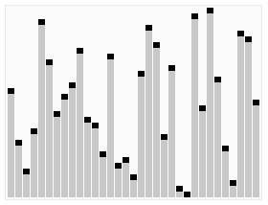

Quicksort example
We are calling quicksort( array, 0, 25 )
Continue searching
low = 12;
high = 15;
0 | 1 | 2 | 3 | 4 | 5 | 6 | 7 | 8 | 9 | 10 | 11 | 12 | 13 | 14 | 15 | 16 | 17 | 18 | 19 | 20 | 21 | 22 | 23 | 24
13 | 51 | 49 | 35 | 7 | 48 | 55 | 23 | 15 | 3 | 28 | 37 | 62 | 99 | 17 | 32 | 94 | 89 | 95 | 73 | 61 | 77 | 88 | 97
pivot = 57;
quicksort( array, 0, 25 )

Slide 44
Quicksort example
We are calling quicksort( array, 0, 25 )
Continue searching
low = 12;
high = 15;
Swap them
0 | 1 | 2 | 3 | 4 | 5 | 6 | 7 | 8 | 9 | 10 | 11 | 12 | 13 | 14 | 15 | 16 | 17 | 18 | 19 | 20 | 21 | 22 | 23 | 24
13 | 51 | 49 | 35 | 7 | 48 | 55 | 23 | 15 | 3 | 28 | 37 | 32 | 99 | 17 | 62 | 94 | 89 | 95 | 73 | 61 | 77 | 88 | 97
pivot = 57;
quicksort( array, 0, 25 )

Slide 45
Quicksort example
We are calling quicksort( array, 0, 25 )
Continue searching
low = 13;
high = 14;
0 | 1 | 2 | 3 | 4 | 5 | 6 | 7 | 8 | 9 | 10 | 11 | 12 | 13 | 14 | 15 | 16 | 17 | 18 | 19 | 20 | 21 | 22 | 23 | 24
13 | 51 | 49 | 35 | 7 | 48 | 55 | 23 | 15 | 3 | 28 | 37 | 32 | 99 | 17 | 62 | 94 | 89 | 95 | 73 | 61 | 77 | 88 | 97
pivot = 57;
quicksort( array, 0, 25 )

Slide 46
Quicksort example
We are calling quicksort( array, 0, 25 )
Continue searching
low = 13;
high = 14;
Swap them
0 | 1 | 2 | 3 | 4 | 5 | 6 | 7 | 8 | 9 | 10 | 11 | 12 | 13 | 14 | 15 | 16 | 17 | 18 | 19 | 20 | 21 | 22 | 23 | 24
13 | 51 | 49 | 35 | 7 | 48 | 55 | 23 | 15 | 3 | 28 | 37 | 32 | 17 | 99 | 62 | 94 | 89 | 95 | 73 | 61 | 77 | 88 | 97
pivot = 57;
quicksort( array, 0, 25 )

Slide 47
Quicksort example
We are calling quicksort( array, 0, 25 )
Continue searching
low = 14;
high = 13;
Now, low > high, so we stop
0 | 1 | 2 | 3 | 4 | 5 | 6 | 7 | 8 | 9 | 10 | 11 | 12 | 13 | 14 | 15 | 16 | 17 | 18 | 19 | 20 | 21 | 22 | 23 | 24
13 | 51 | 49 | 35 | 7 | 48 | 55 | 23 | 15 | 3 | 28 | 37 | 32 | 17 | 99 | 62 | 94 | 89 | 95 | 73 | 61 | 77 | 88 | 97
pivot = 57;
quicksort( array, 0, 25 )

Slide 48
Quicksort example
We are calling quicksort( array, 0, 25 )
Continue searching
low = 14;
high = 13;
Now, low > high, so we stop
0 | 1 | 2 | 3 | 4 | 5 | 6 | 7 | 8 | 9 | 10 | 11 | 12 | 13 | 14 | 15 | 16 | 17 | 18 | 19 | 20 | 21 | 22 | 23 | 24
13 | 51 | 49 | 35 | 7 | 48 | 55 | 23 | 15 | 3 | 28 | 37 | 32 | 17 | 57 | 62 | 94 | 89 | 95 | 73 | 61 | 77 | 88 | 97 | 99
pivot = 57;
quicksort( array, 0, 25 )

Slide 49
Quicksort example
We are calling quicksort( array, 0, 25 )
We now begin calling quicksort recursively on the first half
quicksort( array, 0, 14 );
0 | 1 | 2 | 3 | 4 | 5 | 6 | 7 | 8 | 9 | 10 | 11 | 12 | 13 | 14 | 15 | 16 | 17 | 18 | 19 | 20 | 21 | 22 | 23 | 24
13 | 51 | 49 | 35 | 7 | 48 | 55 | 23 | 15 | 3 | 28 | 37 | 32 | 17 | 57 | 62 | 94 | 89 | 95 | 73 | 61 | 77 | 88 | 97 | 99
quicksort( array, 0, 25 )

Slide 50
Quicksort example
We are executing quicksort( array, 0, 14 )
First, 14 – 0 > 6, so find the midpoint and the pivot
midpoint = (0 + 14)/2; // == 7
0 | 1 | 2 | 3 | 4 | 5 | 6 | 7 | 8 | 9 | 10 | 11 | 12 | 13 | 14 | 15 | 16 | 17 | 18 | 19 | 20 | 21 | 22 | 23 | 24
13 | 51 | 49 | 35 | 7 | 48 | 55 | 23 | 15 | 3 | 28 | 37 | 32 | 17 | 57 | 62 | 94 | 89 | 95 | 73 | 61 | 77 | 88 | 97 | 99
quicksort( array, 0, 14 )
quicksort( array, 0, 25 )

Slide 51
Quicksort example
We are executing quicksort( array, 0, 14 )
First, 14 – 0 > 6, so find the midpoint and the pivot
midpoint = (0 + 14)/2; // == 7
pivot = 17
0 | 1 | 2 | 3 | 4 | 5 | 6 | 7 | 8 | 9 | 10 | 11 | 12 | 13 | 14 | 15 | 16 | 17 | 18 | 19 | 20 | 21 | 22 | 23 | 24
13 | 51 | 49 | 35 | 7 | 48 | 55 | 23 | 15 | 3 | 28 | 37 | 32 | 17 | 57 | 62 | 94 | 89 | 95 | 73 | 61 | 77 | 88 | 97 | 99
quicksort( array, 0, 14 )
quicksort( array, 0, 25 )

Slide 52
Quicksort example
We are executing quicksort( array, 0, 14 )
First, 14 – 0 > 6, so find the midpoint and the pivot
midpoint = (0 + 14)/2; // == 7
0 | 1 | 2 | 3 | 4 | 5 | 6 | 7 | 8 | 9 | 10 | 11 | 12 | 13 | 14 | 15 | 16 | 17 | 18 | 19 | 20 | 21 | 22 | 23 | 24
13 | 51 | 49 | 35 | 7 | 48 | 55 | 23 | 15 | 3 | 28 | 37 | 32 |  | 57 | 62 | 94 | 89 | 95 | 73 | 61 | 77 | 88 | 97 | 99
pivot = 17;
quicksort( array, 0, 14 )
quicksort( array, 0, 25 )

Slide 53
Quicksort example
We are executing quicksort( array, 0, 14 )
Starting from the front and back:
Find the next element greater than the pivot
The last element less than the pivot
0 | 1 | 2 | 3 | 4 | 5 | 6 | 7 | 8 | 9 | 10 | 11 | 12 | 13 | 14 | 15 | 16 | 17 | 18 | 19 | 20 | 21 | 22 | 23 | 24
13 | 51 | 49 | 35 | 7 | 48 | 55 | 23 | 15 | 3 | 28 | 37 | 32 |  | 57 | 62 | 94 | 89 | 95 | 73 | 61 | 77 | 88 | 97 | 99
pivot = 17;
quicksort( array, 0, 14 )
quicksort( array, 0, 25 )

Slide 54
Quicksort example
We are executing quicksort( array, 0, 14 )
Searching forward and backward:
low = 1;
high = 9;
0 | 1 | 2 | 3 | 4 | 5 | 6 | 7 | 8 | 9 | 10 | 11 | 12 | 13 | 14 | 15 | 16 | 17 | 18 | 19 | 20 | 21 | 22 | 23 | 24
13 | 51 | 49 | 35 | 7 | 48 | 55 | 23 | 15 | 3 | 28 | 37 | 32 |  | 57 | 62 | 94 | 89 | 95 | 73 | 61 | 77 | 88 | 97 | 99
pivot = 17;
quicksort( array, 0, 14 )
quicksort( array, 0, 25 )

Slide 55
Quicksort example
We are executing quicksort( array, 0, 14 )
Searching forward and backward:
low = 1;
high = 9;
Swap them
0 | 1 | 2 | 3 | 4 | 5 | 6 | 7 | 8 | 9 | 10 | 11 | 12 | 13 | 14 | 15 | 16 | 17 | 18 | 19 | 20 | 21 | 22 | 23 | 24
13 | 3 | 49 | 35 | 7 | 48 | 55 | 23 | 15 | 51 | 28 | 37 | 32 |  | 57 | 62 | 94 | 89 | 95 | 73 | 61 | 77 | 88 | 97 | 99
pivot = 17;
quicksort( array, 0, 14 )
quicksort( array, 0, 25 )

Slide 56
Quicksort example
We are executing quicksort( array, 0, 14 )
Searching forward and backward:
low = 2;
high = 8;
0 | 1 | 2 | 3 | 4 | 5 | 6 | 7 | 8 | 9 | 10 | 11 | 12 | 13 | 14 | 15 | 16 | 17 | 18 | 19 | 20 | 21 | 22 | 23 | 24
13 | 3 | 49 | 35 | 7 | 48 | 55 | 23 | 15 | 51 | 28 | 37 | 32 |  | 57 | 62 | 94 | 89 | 95 | 73 | 61 | 77 | 88 | 97 | 99
pivot = 17;
quicksort( array, 0, 14 )
quicksort( array, 0, 25 )

Slide 57
Quicksort example
We are executing quicksort( array, 0, 14 )
Searching forward and backward:
low = 2;
high = 8;
Swap them
0 | 1 | 2 | 3 | 4 | 5 | 6 | 7 | 8 | 9 | 10 | 11 | 12 | 13 | 14 | 15 | 16 | 17 | 18 | 19 | 20 | 21 | 22 | 23 | 24
13 | 3 | 15 | 35 | 7 | 48 | 55 | 23 | 49 | 51 | 28 | 37 | 32 |  | 57 | 62 | 94 | 89 | 95 | 73 | 61 | 77 | 88 | 97 | 99
pivot = 17;
quicksort( array, 0, 14 )
quicksort( array, 0, 25 )

Slide 58
Quicksort example
We are executing quicksort( array, 0, 14 )
Searching forward and backward:
low = 3;
high = 4;
0 | 1 | 2 | 3 | 4 | 5 | 6 | 7 | 8 | 9 | 10 | 11 | 12 | 13 | 14 | 15 | 16 | 17 | 18 | 19 | 20 | 21 | 22 | 23 | 24
13 | 3 | 15 | 35 | 7 | 48 | 55 | 23 | 49 | 51 | 28 | 37 | 32 |  | 57 | 62 | 94 | 89 | 95 | 73 | 61 | 77 | 88 | 97 | 99
pivot = 17;
quicksort( array, 0, 14 )
quicksort( array, 0, 25 )

Slide 59
Quicksort example
We are executing quicksort( array, 0, 14 )
Searching forward and backward:
low = 3;
high = 4;
Swap them
0 | 1 | 2 | 3 | 4 | 5 | 6 | 7 | 8 | 9 | 10 | 11 | 12 | 13 | 14 | 15 | 16 | 17 | 18 | 19 | 20 | 21 | 22 | 23 | 24
13 | 3 | 15 | 7 | 35 | 48 | 55 | 23 | 49 | 51 | 28 | 37 | 32 |  | 57 | 62 | 94 | 89 | 95 | 73 | 61 | 77 | 88 | 97 | 99
pivot = 17;
quicksort( array, 0, 14 )
quicksort( array, 0, 25 )

Slide 60
Quicksort example
We are executing quicksort( array, 0, 14 )
Searching forward and backward:
low = 4;
high = 3;
Now, low > high, so we stop
0 | 1 | 2 | 3 | 4 | 5 | 6 | 7 | 8 | 9 | 10 | 11 | 12 | 13 | 14 | 15 | 16 | 17 | 18 | 19 | 20 | 21 | 22 | 23 | 24
13 | 3 | 15 | 7 | 35 | 48 | 55 | 23 | 49 | 51 | 28 | 37 | 32 |  | 57 | 62 | 94 | 89 | 95 | 73 | 61 | 77 | 88 | 97 | 99
pivot = 17;
quicksort( array, 0, 14 )
quicksort( array, 0, 25 )

Slide 61
Quicksort example
We are executing quicksort( array, 0, 14 )
We continue calling quicksort recursively
quicksort( array, 0, 4 );
0 | 1 | 2 | 3 | 4 | 5 | 6 | 7 | 8 | 9 | 10 | 11 | 12 | 13 | 14 | 15 | 16 | 17 | 18 | 19 | 20 | 21 | 22 | 23 | 24
13 | 3 | 15 | 7 | 17 | 48 | 55 | 23 | 49 | 51 | 28 | 37 | 32 | 35 | 57 | 62 | 94 | 89 | 95 | 73 | 61 | 77 | 88 | 97 | 99
quicksort( array, 0, 14 )
quicksort( array, 0, 25 )

Slide 62
Quicksort example
We are executing quicksort( array, 0, 4 )
Now, 4 – 0 ≤ 6, so find we call insertion sort
0 | 1 | 2 | 3 | 4 | 5 | 6 | 7 | 8 | 9 | 10 | 11 | 12 | 13 | 14 | 15 | 16 | 17 | 18 | 19 | 20 | 21 | 22 | 23 | 24
13 | 3 | 15 | 7 | 17 | 48 | 55 | 23 | 49 | 51 | 28 | 37 | 32 | 35 | 57 | 62 | 94 | 89 | 95 | 73 | 61 | 77 | 88 | 97 | 99
quicksort( array, 0, 4 )
quicksort( array, 0, 14 )
quicksort( array, 0, 25 )

Slide 63
Quicksort example
Insertion sort just sorts the entries from 0 to 3
0 | 1 | 2 | 3 | 4 | 5 | 6 | 7 | 8 | 9 | 10 | 11 | 12 | 13 | 14 | 15 | 16 | 17 | 18 | 19 | 20 | 21 | 22 | 23 | 24
13 | 3 | 15 | 7 | 17 | 48 | 55 | 23 | 49 | 51 | 28 | 37 | 32 | 35 | 57 | 62 | 94 | 89 | 95 | 73 | 61 | 77 | 88 | 97 | 99
insertion_sort( array, 0, 4 )
quicksort( array, 0, 4 )
quicksort( array, 0, 14 )
quicksort( array, 0, 25 )

Slide 64
Quicksort example
Insertion sort just sorts the entries from 0 to 3
This function call completes and so we exit
0 | 1 | 2 | 3 | 4 | 5 | 6 | 7 | 8 | 9 | 10 | 11 | 12 | 13 | 14 | 15 | 16 | 17 | 18 | 19 | 20 | 21 | 22 | 23 | 24
3 | 7 | 13 | 15 | 17 | 48 | 55 | 23 | 49 | 51 | 28 | 37 | 32 | 35 | 57 | 62 | 94 | 89 | 95 | 73 | 61 | 77 | 88 | 97 | 99
insertion_sort( array, 0, 4 )
quicksort( array, 0, 4 )
quicksort( array, 0, 14 )
quicksort( array, 0, 25 )

Slide 65
Quicksort example
This call to quicksort is now also finished, so it, too, exits
0 | 1 | 2 | 3 | 4 | 5 | 6 | 7 | 8 | 9 | 10 | 11 | 12 | 13 | 14 | 15 | 16 | 17 | 18 | 19 | 20 | 21 | 22 | 23 | 24
3 | 7 | 13 | 15 | 17 | 48 | 55 | 23 | 49 | 51 | 28 | 37 | 32 | 35 | 57 | 62 | 94 | 89 | 95 | 73 | 61 | 77 | 88 | 97 | 99
quicksort( array, 0, 4 )
quicksort( array, 0, 14 )
quicksort( array, 0, 25 )

Slide 66
Quicksort example
We are back to executing quicksort( array, 0, 14 )
We continue calling quicksort recursively on the second half
quicksort( array, 0, 4 );
quicksort( array, 5, 14 );
0 | 1 | 2 | 3 | 4 | 5 | 6 | 7 | 8 | 9 | 10 | 11 | 12 | 13 | 14 | 15 | 16 | 17 | 18 | 19 | 20 | 21 | 22 | 23 | 24
3 | 7 | 13 | 15 | 17 | 48 | 55 | 23 | 49 | 51 | 28 | 37 | 32 | 35 | 57 | 62 | 94 | 89 | 95 | 73 | 61 | 77 | 88 | 97 | 99
quicksort( array, 0, 14 )
quicksort( array, 0, 25 )

Slide 67
Quicksort example
We now are calling quicksort( array, 5, 14 )
First, 14 – 5 > 6, so find the midpoint and the pivot
midpoint = (5 + 14)/2; // == 9
0 | 1 | 2 | 3 | 4 | 5 | 6 | 7 | 8 | 9 | 10 | 11 | 12 | 13 | 14 | 15 | 16 | 17 | 18 | 19 | 20 | 21 | 22 | 23 | 24
3 | 7 | 13 | 15 | 17 | 48 | 55 | 23 | 49 | 51 | 28 | 37 | 32 | 35 | 57 | 62 | 94 | 89 | 95 | 73 | 61 | 77 | 88 | 97 | 99
quicksort( array, 5, 14 )
quicksort( array, 0, 14 )
quicksort( array, 0, 25 )

Slide 68
Quicksort example
We now are calling quicksort( array, 5, 14 )
First, 14 – 5 > 6, so find the midpoint and the pivot
midpoint = (5 + 14)/2; // == 9
pivot = 48
0 | 1 | 2 | 3 | 4 | 5 | 6 | 7 | 8 | 9 | 10 | 11 | 12 | 13 | 14 | 15 | 16 | 17 | 18 | 19 | 20 | 21 | 22 | 23 | 24
3 | 7 | 13 | 15 | 17 | 48 | 55 | 23 | 49 | 51 | 28 | 37 | 32 | 35 | 57 | 62 | 94 | 89 | 95 | 73 | 61 | 77 | 88 | 97 | 99
quicksort( array, 5, 14 )
quicksort( array, 0, 14 )
quicksort( array, 0, 25 )

Slide 69
Quicksort example
We now are calling quicksort( array, 5, 14 )
First, 14 – 5 > 6, so find the midpoint and the pivot
midpoint = (5 + 14)/2; // == 9
pivot = 48
0 | 1 | 2 | 3 | 4 | 5 | 6 | 7 | 8 | 9 | 10 | 11 | 12 | 13 | 14 | 15 | 16 | 17 | 18 | 19 | 20 | 21 | 22 | 23 | 24
3 | 7 | 13 | 15 | 17 | 35 | 55 | 23 | 49 | 51 | 28 | 37 | 32 |  | 57 | 62 | 94 | 89 | 95 | 73 | 61 | 77 | 88 | 97 | 99
quicksort( array, 5, 14 )
quicksort( array, 0, 14 )
quicksort( array, 0, 25 )

Slide 70
Quicksort example
We now are calling quicksort( array, 5, 14 )
Starting from the front and back:
Find the next element greater than the pivot
The last element less than the pivot
0 | 1 | 2 | 3 | 4 | 5 | 6 | 7 | 8 | 9 | 10 | 11 | 12 | 13 | 14 | 15 | 16 | 17 | 18 | 19 | 20 | 21 | 22 | 23 | 24
3 | 7 | 13 | 15 | 17 | 35 | 55 | 23 | 49 | 51 | 28 | 37 | 32 |  | 57 | 62 | 94 | 89 | 95 | 73 | 61 | 77 | 88 | 97 | 99
pivot = 48;
quicksort( array, 5, 14 )
quicksort( array, 0, 14 )
quicksort( array, 0, 25 )

Slide 71
Quicksort example
We now are calling quicksort( array, 5, 14 )
Searching forward and backward:
low = 6;
high = 12;
0 | 1 | 2 | 3 | 4 | 5 | 6 | 7 | 8 | 9 | 10 | 11 | 12 | 13 | 14 | 15 | 16 | 17 | 18 | 19 | 20 | 21 | 22 | 23 | 24
3 | 7 | 13 | 15 | 17 | 35 | 55 | 23 | 49 | 51 | 28 | 37 | 32 |  | 57 | 62 | 94 | 89 | 95 | 73 | 61 | 77 | 88 | 97 | 99
pivot = 48;
quicksort( array, 5, 14 )
quicksort( array, 0, 14 )
quicksort( array, 0, 25 )

Slide 72
Quicksort example
We now are calling quicksort( array, 5, 14 )
Searching forward and backward:
low = 6;
high = 12;
Swap them
0 | 1 | 2 | 3 | 4 | 5 | 6 | 7 | 8 | 9 | 10 | 11 | 12 | 13 | 14 | 15 | 16 | 17 | 18 | 19 | 20 | 21 | 22 | 23 | 24
3 | 7 | 13 | 15 | 17 | 35 | 32 | 23 | 49 | 51 | 28 | 37 | 55 |  | 57 | 62 | 94 | 89 | 95 | 73 | 61 | 77 | 88 | 97 | 99
pivot = 48;
quicksort( array, 5, 14 )
quicksort( array, 0, 14 )
quicksort( array, 0, 25 )

Slide 73
Quicksort example
We now are calling quicksort( array, 5, 14 )
Continue searching
low = 8;
high = 11;
0 | 1 | 2 | 3 | 4 | 5 | 6 | 7 | 8 | 9 | 10 | 11 | 12 | 13 | 14 | 15 | 16 | 17 | 18 | 19 | 20 | 21 | 22 | 23 | 24
3 | 7 | 13 | 15 | 17 | 35 | 32 | 23 | 49 | 51 | 28 | 37 | 55 |  | 57 | 62 | 94 | 89 | 95 | 73 | 61 | 77 | 88 | 97 | 99
pivot = 48;
quicksort( array, 5, 14 )
quicksort( array, 0, 14 )
quicksort( array, 0, 25 )

Slide 74
Quicksort example
We now are calling quicksort( array, 5, 14 )
Continue searching
low = 8;
high = 11;
Swap them
0 | 1 | 2 | 3 | 4 | 5 | 6 | 7 | 8 | 9 | 10 | 11 | 12 | 13 | 14 | 15 | 16 | 17 | 18 | 19 | 20 | 21 | 22 | 23 | 24
3 | 7 | 13 | 15 | 17 | 35 | 32 | 23 | 37 | 51 | 28 | 49 | 55 |  | 57 | 62 | 94 | 89 | 95 | 73 | 61 | 77 | 88 | 97 | 99
pivot = 48;
quicksort( array, 5, 14 )
quicksort( array, 0, 14 )
quicksort( array, 0, 25 )

Slide 75
Quicksort example
We now are calling quicksort( array, 5, 14 )
Continue searching
low = 8;
high = 11;
0 | 1 | 2 | 3 | 4 | 5 | 6 | 7 | 8 | 9 | 10 | 11 | 12 | 13 | 14 | 15 | 16 | 17 | 18 | 19 | 20 | 21 | 22 | 23 | 24
3 | 7 | 13 | 15 | 17 | 35 | 32 | 23 | 37 | 51 | 28 | 49 | 55 |  | 57 | 62 | 94 | 89 | 95 | 73 | 61 | 77 | 88 | 97 | 99
pivot = 48;
quicksort( array, 5, 14 )
quicksort( array, 0, 14 )
quicksort( array, 0, 25 )

Slide 76
Quicksort example
We now are calling quicksort( array, 5, 14 )
Continue searching
low = 8;
high = 11;
Swap them
0 | 1 | 2 | 3 | 4 | 5 | 6 | 7 | 8 | 9 | 10 | 11 | 12 | 13 | 14 | 15 | 16 | 17 | 18 | 19 | 20 | 21 | 22 | 23 | 24
3 | 7 | 13 | 15 | 17 | 35 | 32 | 23 | 37 | 28 | 51 | 49 | 55 |  | 57 | 62 | 94 | 89 | 95 | 73 | 61 | 77 | 88 | 97 | 99
pivot = 48;
quicksort( array, 5, 14 )
quicksort( array, 0, 14 )
quicksort( array, 0, 25 )

Slide 77
Quicksort example
We now are calling quicksort( array, 5, 14 )
Continue searching
low = 8;
high = 11;
Now, low > high, so we stop
0 | 1 | 2 | 3 | 4 | 5 | 6 | 7 | 8 | 9 | 10 | 11 | 12 | 13 | 14 | 15 | 16 | 17 | 18 | 19 | 20 | 21 | 22 | 23 | 24
3 | 7 | 13 | 15 | 17 | 35 | 32 | 23 | 37 | 28 | 51 | 49 | 55 |  | 57 | 62 | 94 | 89 | 95 | 73 | 61 | 77 | 88 | 97 | 99
pivot = 48;
quicksort( array, 5, 14 )
quicksort( array, 0, 14 )
quicksort( array, 0, 25 )

Slide 78
Quicksort example
We now are calling quicksort( array, 5, 14 )
Continue searching
low = 8;
high = 11;
Now, low > high, so we stop
0 | 1 | 2 | 3 | 4 | 5 | 6 | 7 | 8 | 9 | 10 | 11 | 12 | 13 | 14 | 15 | 16 | 17 | 18 | 19 | 20 | 21 | 22 | 23 | 24
3 | 7 | 13 | 15 | 17 | 35 | 32 | 23 | 37 | 28 | 48 | 49 | 55 | 51 | 57 | 62 | 94 | 89 | 95 | 73 | 61 | 77 | 88 | 97 | 99
pivot = 48;
quicksort( array, 5, 14 )
quicksort( array, 0, 14 )
quicksort( array, 0, 25 )

Slide 79
Quicksort example
We now are calling quicksort( array, 5, 14 )
We now begin calling quicksort recursively on the first half
quicksort( array, 5, 10 );
0 | 1 | 2 | 3 | 4 | 5 | 6 | 7 | 8 | 9 | 10 | 11 | 12 | 13 | 14 | 15 | 16 | 17 | 18 | 19 | 20 | 21 | 22 | 23 | 24
3 | 7 | 13 | 15 | 17 | 35 | 32 | 23 | 37 | 28 | 48 | 49 | 55 | 51 | 57 | 62 | 94 | 89 | 95 | 73 | 61 | 77 | 88 | 97 | 99
quicksort( array, 5, 14 )
quicksort( array, 0, 14 )
quicksort( array, 0, 25 )

Slide 80
Quicksort example
We now are calling quicksort( array, 5, 14 )
We now begin calling quicksort recursively
quicksort( array, 5, 10 );
0 | 1 | 2 | 3 | 4 | 5 | 6 | 7 | 8 | 9 | 10 | 11 | 12 | 13 | 14 | 15 | 16 | 17 | 18 | 19 | 20 | 21 | 22 | 23 | 24
3 | 7 | 13 | 15 | 17 | 35 | 32 | 23 | 37 | 28 | 48 | 49 | 55 | 51 | 57 | 62 | 94 | 89 | 95 | 73 | 61 | 77 | 88 | 97 | 99
quicksort( array, 5, 14 )
quicksort( array, 0, 14 )
quicksort( array, 0, 25 )

Slide 81
Quicksort example
We are executing quicksort( array, 5, 10 )
Now, 10 – 5 ≤ 6, so find we call insertion sort
0 | 1 | 2 | 3 | 4 | 5 | 6 | 7 | 8 | 9 | 10 | 11 | 12 | 13 | 14 | 15 | 16 | 17 | 18 | 19 | 20 | 21 | 22 | 23 | 24
3 | 7 | 13 | 15 | 17 | 35 | 32 | 23 | 37 | 28 | 48 | 49 | 55 | 51 | 57 | 62 | 94 | 89 | 95 | 73 | 61 | 77 | 88 | 97 | 99
quicksort( array, 5, 10 )
quicksort( array, 5, 14 )
quicksort( array, 0, 14 )
quicksort( array, 0, 25 )

Slide 82
Quicksort example
Insertion sort just sorts the entries from 5 to 9
0 | 1 | 2 | 3 | 4 | 5 | 6 | 7 | 8 | 9 | 10 | 11 | 12 | 13 | 14 | 15 | 16 | 17 | 18 | 19 | 20 | 21 | 22 | 23 | 24
3 | 7 | 13 | 15 | 17 | 35 | 32 | 23 | 37 | 28 | 48 | 49 | 55 | 51 | 57 | 62 | 94 | 89 | 95 | 73 | 61 | 77 | 88 | 97 | 99
insertion_sort( array, 5, 10 )
quicksort( array, 5, 10 )
quicksort( array, 5, 14 )
quicksort( array, 0, 14 )
quicksort( array, 0, 25 )

Slide 83
Quicksort example
Insertion sort just sorts the entries from 5 to 9
This function call completes and so we exit
0 | 1 | 2 | 3 | 4 | 5 | 6 | 7 | 8 | 9 | 10 | 11 | 12 | 13 | 14 | 15 | 16 | 17 | 18 | 19 | 20 | 21 | 22 | 23 | 24
3 | 7 | 13 | 15 | 17 | 23 | 28 | 32 | 35 | 37 | 48 | 49 | 55 | 51 | 57 | 62 | 94 | 89 | 95 | 73 | 61 | 77 | 88 | 97 | 99
insertion_sort( array, 5, 10 )
quicksort( array, 5, 10 )
quicksort( array, 5, 14 )
quicksort( array, 0, 14 )
quicksort( array, 0, 25 )

Slide 84
Quicksort example
This call to quicksort is now also finished, so it, too, exits
0 | 1 | 2 | 3 | 4 | 5 | 6 | 7 | 8 | 9 | 10 | 11 | 12 | 13 | 14 | 15 | 16 | 17 | 18 | 19 | 20 | 21 | 22 | 23 | 24
3 | 7 | 13 | 15 | 17 | 23 | 28 | 32 | 35 | 37 | 48 | 49 | 55 | 51 | 57 | 62 | 94 | 89 | 95 | 73 | 61 | 77 | 88 | 97 | 99
quicksort( array, 5, 10 )
quicksort( array, 5, 14 )
quicksort( array, 0, 14 )
quicksort( array, 0, 25 )

Slide 85
Quicksort example
We are back to executing quicksort( array, 5, 14 )
We continue calling quicksort recursively on the second half
quicksort( array, 5, 10 );
quicksort( array, 6, 14 );
0 | 1 | 2 | 3 | 4 | 5 | 6 | 7 | 8 | 9 | 10 | 11 | 12 | 13 | 14 | 15 | 16 | 17 | 18 | 19 | 20 | 21 | 22 | 23 | 24
3 | 7 | 13 | 15 | 17 | 23 | 28 | 32 | 35 | 37 | 48 | 49 | 55 | 51 | 57 | 62 | 94 | 89 | 95 | 73 | 61 | 77 | 88 | 97 | 99
quicksort( array, 5, 14 )
quicksort( array, 0, 14 )
quicksort( array, 0, 25 )

Slide 86
Quicksort example
We are executing quicksort( array, 11, 15 )
Now, 15 – 11 ≤ 6, so find we call insertion sort
0 | 1 | 2 | 3 | 4 | 5 | 6 | 7 | 8 | 9 | 10 | 11 | 12 | 13 | 14 | 15 | 16 | 17 | 18 | 19 | 20 | 21 | 22 | 23 | 24
3 | 7 | 13 | 15 | 17 | 23 | 28 | 32 | 35 | 37 | 48 | 49 | 55 | 51 | 57 | 62 | 94 | 89 | 95 | 73 | 61 | 77 | 88 | 97 | 99
quicksort( array, 6, 14 )
quicksort( array, 5, 14 )
quicksort( array, 0, 14 )
quicksort( array, 0, 25 )

Slide 87
Quicksort example
Insertion sort just sorts the entries from 11 to 14
0 | 1 | 2 | 3 | 4 | 5 | 6 | 7 | 8 | 9 | 10 | 11 | 12 | 13 | 14 | 15 | 16 | 17 | 18 | 19 | 20 | 21 | 22 | 23 | 24
3 | 7 | 13 | 15 | 17 | 23 | 28 | 32 | 35 | 37 | 48 | 49 | 55 | 51 | 57 | 62 | 94 | 89 | 95 | 73 | 61 | 77 | 88 | 97 | 99
insertion_sort( array, 11, 14 )
quicksort( array, 11, 14 )
quicksort( array, 5, 14 )
quicksort( array, 0, 14 )
quicksort( array, 0, 25 )

Slide 88
Quicksort example
Insertion sort just sorts the entries from 11 to 14
This function call completes and so we exit
0 | 1 | 2 | 3 | 4 | 5 | 6 | 7 | 8 | 9 | 10 | 11 | 12 | 13 | 14 | 15 | 16 | 17 | 18 | 19 | 20 | 21 | 22 | 23 | 24
3 | 7 | 13 | 15 | 17 | 23 | 28 | 32 | 35 | 37 | 48 | 49 | 51 | 55 | 57 | 62 | 94 | 89 | 95 | 73 | 61 | 77 | 88 | 97 | 99
insertion_sort( array, 11, 14 )
quicksort( array, 11, 14 )
quicksort( array, 5, 14 )
quicksort( array, 0, 14 )
quicksort( array, 0, 25 )

Slide 89
Quicksort example
This call to quicksort is now also finished, so it, too, exits
0 | 1 | 2 | 3 | 4 | 5 | 6 | 7 | 8 | 9 | 10 | 11 | 12 | 13 | 14 | 15 | 16 | 17 | 18 | 19 | 20 | 21 | 22 | 23 | 24
3 | 7 | 13 | 15 | 17 | 23 | 28 | 32 | 35 | 37 | 48 | 49 | 51 | 55 | 57 | 62 | 94 | 89 | 95 | 73 | 61 | 77 | 88 | 97 | 99
quicksort( array, 11, 14 )
quicksort( array, 5, 14 )
quicksort( array, 0, 14 )
quicksort( array, 0, 25 )

Slide 90
Quicksort example
This call to quicksort is now also finished, so it, too, exits
0 | 1 | 2 | 3 | 4 | 5 | 6 | 7 | 8 | 9 | 10 | 11 | 12 | 13 | 14 | 15 | 16 | 17 | 18 | 19 | 20 | 21 | 22 | 23 | 24
3 | 7 | 13 | 15 | 17 | 23 | 28 | 32 | 35 | 37 | 48 | 49 | 51 | 55 | 57 | 62 | 94 | 89 | 95 | 73 | 61 | 77 | 88 | 97 | 99
quicksort( array, 5, 14 )
quicksort( array, 0, 14 )
quicksort( array, 0, 25 )

Slide 91
Quicksort example
This call to quicksort is now also finished, so it, too, exits
0 | 1 | 2 | 3 | 4 | 5 | 6 | 7 | 8 | 9 | 10 | 11 | 12 | 13 | 14 | 15 | 16 | 17 | 18 | 19 | 20 | 21 | 22 | 23 | 24
3 | 7 | 13 | 15 | 17 | 23 | 28 | 32 | 35 | 37 | 48 | 49 | 51 | 55 | 57 | 62 | 94 | 89 | 95 | 73 | 61 | 77 | 88 | 97 | 99
quicksort( array, 0, 14 )
quicksort( array, 0, 25 )

Slide 92
Quicksort example
We are back to executing quicksort( array, 0, 25 )
We continue calling quicksort recursively on the second half
quicksort( array, 0, 14 );
quicksort( array, 15, 25 );
0 | 1 | 2 | 3 | 4 | 5 | 6 | 7 | 8 | 9 | 10 | 11 | 12 | 13 | 14 | 15 | 16 | 17 | 18 | 19 | 20 | 21 | 22 | 23 | 24
3 | 7 | 13 | 15 | 17 | 23 | 28 | 32 | 35 | 37 | 48 | 49 | 51 | 55 | 57 | 62 | 94 | 89 | 95 | 73 | 61 | 77 | 88 | 97 | 99
quicksort( array, 0, 25 )

Slide 93
Quicksort example
We are back to executing quicksort( array, 15, 25 )
First, 25 – 15 > 6, so find the midpoint and the pivot
midpoint = (15 + 25)/2; // == 20
0 | 1 | 2 | 3 | 4 | 5 | 6 | 7 | 8 | 9 | 10 | 11 | 12 | 13 | 14 | 15 | 16 | 17 | 18 | 19 | 20 | 21 | 22 | 23 | 24
3 | 7 | 13 | 15 | 17 | 23 | 28 | 32 | 35 | 37 | 48 | 49 | 51 | 55 | 57 | 62 | 94 | 89 | 95 | 73 | 61 | 77 | 88 | 97 | 99
quicksort( array, 15, 25 )
quicksort( array, 0, 25 )

Slide 94
Quicksort example
We are back to executing quicksort( array, 15, 25 )
First, 25 – 15 > 6, so find the midpoint and the pivot
midpoint = (15 + 25)/2; // == 20
pivot = 62;
0 | 1 | 2 | 3 | 4 | 5 | 6 | 7 | 8 | 9 | 10 | 11 | 12 | 13 | 14 | 15 | 16 | 17 | 18 | 19 | 20 | 21 | 22 | 23 | 24
3 | 7 | 13 | 15 | 17 | 23 | 28 | 32 | 35 | 37 | 48 | 49 | 51 | 55 | 57 | 61 | 94 | 89 | 95 | 73 | 99 | 77 | 88 | 97
quicksort( array, 15, 25 )
quicksort( array, 0, 25 )

Slide 95
Quicksort example
We are back to executing quicksort( array, 15, 25 )
Searching forward and backward:
low = 16;
high = 15;
Now, low > high, so we stop
0 | 1 | 2 | 3 | 4 | 5 | 6 | 7 | 8 | 9 | 10 | 11 | 12 | 13 | 14 | 15 | 16 | 17 | 18 | 19 | 20 | 21 | 22 | 23 | 24
3 | 7 | 13 | 15 | 17 | 23 | 28 | 32 | 35 | 37 | 48 | 49 | 51 | 55 | 57 | 61 | 94 | 89 | 95 | 73 | 99 | 77 | 88 | 97
pivot = 62;
quicksort( array, 15, 25 )
quicksort( array, 0, 25 )

Slide 96
Quicksort example
We are back to executing quicksort( array, 15, 25 )
Searching forward and backward:
low = 16;
high = 15;
Now, low > high, so we stop
Note, this is the worst-case scenario
The pivot is the second smallest element
0 | 1 | 2 | 3 | 4 | 5 | 6 | 7 | 8 | 9 | 10 | 11 | 12 | 13 | 14 | 15 | 16 | 17 | 18 | 19 | 20 | 21 | 22 | 23 | 24
3 | 7 | 13 | 15 | 17 | 23 | 28 | 32 | 35 | 37 | 48 | 49 | 51 | 55 | 57 | 61 | 62 | 89 | 95 | 73 | 99 | 77 | 88 | 97 | 94
pivot = 62;
quicksort( array, 15, 25 )
quicksort( array, 0, 25 )

Slide 97
Quicksort example
We are back to executing quicksort( array, 15, 25 )
We continue calling quicksort recursively on the first half
quicksort( array, 15, 16 );
0 | 1 | 2 | 3 | 4 | 5 | 6 | 7 | 8 | 9 | 10 | 11 | 12 | 13 | 14 | 15 | 16 | 17 | 18 | 19 | 20 | 21 | 22 | 23 | 24
3 | 7 | 13 | 15 | 17 | 23 | 28 | 32 | 35 | 37 | 48 | 49 | 51 | 55 | 57 | 61 | 62 | 89 | 95 | 73 | 99 | 77 | 88 | 97 | 94
quicksort( array, 15, 16 )
quicksort( array, 15, 25 )
quicksort( array, 0, 25 )

Slide 98
Quicksort example
We are executing quicksort( array, 15, 16 )
Now, 16 – 15 ≤ 6, so find we call insertion sort
0 | 1 | 2 | 3 | 4 | 5 | 6 | 7 | 8 | 9 | 10 | 11 | 12 | 13 | 14 | 15 | 16 | 17 | 18 | 19 | 20 | 21 | 22 | 23 | 24
3 | 7 | 13 | 15 | 17 | 23 | 28 | 32 | 35 | 37 | 48 | 49 | 51 | 55 | 57 | 61 | 62 | 89 | 95 | 73 | 99 | 77 | 88 | 97 | 94
quicksort( array, 15, 16 )
quicksort( array, 15, 25 )
quicksort( array, 0, 25 )

Slide 99
Quicksort example
Insertion sort immediately returns
0 | 1 | 2 | 3 | 4 | 5 | 6 | 7 | 8 | 9 | 10 | 11 | 12 | 13 | 14 | 15 | 16 | 17 | 18 | 19 | 20 | 21 | 22 | 23 | 24
3 | 7 | 13 | 15 | 17 | 23 | 28 | 32 | 35 | 37 | 48 | 49 | 51 | 55 | 57 | 61 | 62 | 89 | 95 | 73 | 99 | 77 | 88 | 97 | 94
insertion_sort( array, 15, 16 )
quicksort( array, 15, 16 )
quicksort( array, 15, 25 )
quicksort( array, 0, 25 )

Slide 100
Quicksort example
This call to quicksort is now also finished, so it, too, exits
0 | 1 | 2 | 3 | 4 | 5 | 6 | 7 | 8 | 9 | 10 | 11 | 12 | 13 | 14 | 15 | 16 | 17 | 18 | 19 | 20 | 21 | 22 | 23 | 24
3 | 7 | 13 | 15 | 17 | 23 | 28 | 32 | 35 | 37 | 48 | 49 | 51 | 55 | 57 | 61 | 62 | 89 | 95 | 73 | 99 | 77 | 88 | 97 | 94
quicksort( array, 15, 16 )
quicksort( array, 15, 25 )
quicksort( array, 0, 25 )

Slide 101
Quicksort example
We are back to executing quicksort( array, 15, 25 )
We continue calling quicksort recursively on the second half
quicksort( array, 15, 16 );
quicksort( array, 17, 25 );
0 | 1 | 2 | 3 | 4 | 5 | 6 | 7 | 8 | 9 | 10 | 11 | 12 | 13 | 14 | 15 | 16 | 17 | 18 | 19 | 20 | 21 | 22 | 23 | 24
3 | 7 | 13 | 15 | 17 | 23 | 28 | 32 | 35 | 37 | 48 | 49 | 51 | 55 | 57 | 61 | 62 | 89 | 95 | 73 | 99 | 77 | 88 | 97 | 94
quicksort( array, 15, 25 )
quicksort( array, 0, 25 )

Slide 102
Quicksort example
We are now calling quicksort( array, 17, 25 )
First, 25 – 17 > 6, so find the midpoint and the pivot
midpoint = (17 + 25)/2; // == 21
0 | 1 | 2 | 3 | 4 | 5 | 6 | 7 | 8 | 9 | 10 | 11 | 12 | 13 | 14 | 15 | 16 | 17 | 18 | 19 | 20 | 21 | 22 | 23 | 24
3 | 7 | 13 | 15 | 17 | 23 | 28 | 32 | 35 | 37 | 48 | 49 | 51 | 55 | 57 | 61 | 62 | 89 | 95 | 73 | 99 | 77 | 88 | 97 | 94
quicksort( array, 17, 25 )
quicksort( array, 15, 25 )
quicksort( array, 0, 25 )

Slide 103
Quicksort example
We are now calling quicksort( array, 17, 25 )
First, 25 – 17 > 6, so find the midpoint and the pivot
midpoint = (17 + 25)/2; // == 21
0 | 1 | 2 | 3 | 4 | 5 | 6 | 7 | 8 | 9 | 10 | 11 | 12 | 13 | 14 | 15 | 16 | 17 | 18 | 19 | 20 | 21 | 22 | 23 | 24
3 | 7 | 13 | 15 | 17 | 23 | 28 | 32 | 35 | 37 | 48 | 49 | 51 | 55 | 57 | 61 | 62 | 89 | 95 | 73 | 99 | 77 | 88 | 97 | 94
quicksort( array, 17, 25 )
quicksort( array, 15, 25 )
quicksort( array, 0, 25 )

Slide 104
Quicksort example
We are now calling quicksort( array, 17, 25 )
First, 25 – 17 > 6, so find the midpoint and the pivot
midpoint = (17 + 25)/2; // == 21
pivot = 89
0 | 1 | 2 | 3 | 4 | 5 | 6 | 7 | 8 | 9 | 10 | 11 | 12 | 13 | 14 | 15 | 16 | 17 | 18 | 19 | 20 | 21 | 22 | 23 | 24
3 | 7 | 13 | 15 | 17 | 23 | 28 | 32 | 35 | 37 | 48 | 49 | 51 | 55 | 57 | 61 | 62 | 89 | 95 | 73 | 99 | 77 | 88 | 97 | 94
quicksort( array, 17, 25 )
quicksort( array, 15, 25 )
quicksort( array, 0, 25 )

Slide 105
Quicksort example
We are now calling quicksort( array, 17, 25 )
First, 25 – 17 > 6, so find the midpoint and the pivot
midpoint = (17 + 25)/2; // == 21
pivot = 89
0 | 1 | 2 | 3 | 4 | 5 | 6 | 7 | 8 | 9 | 10 | 11 | 12 | 13 | 14 | 15 | 16 | 17 | 18 | 19 | 20 | 21 | 22 | 23 | 24
3 | 7 | 13 | 15 | 17 | 23 | 28 | 32 | 35 | 37 | 48 | 49 | 51 | 55 | 57 | 61 | 62 | 77 | 95 | 73 | 99 | 94 | 88 | 97
quicksort( array, 17, 25 )
quicksort( array, 15, 25 )
quicksort( array, 0, 25 )

Slide 106
Quicksort example
We are now calling quicksort( array, 17, 25 )
Searching forward and backward:
low = 18;
high = 22;
0 | 1 | 2 | 3 | 4 | 5 | 6 | 7 | 8 | 9 | 10 | 11 | 12 | 13 | 14 | 15 | 16 | 17 | 18 | 19 | 20 | 21 | 22 | 23 | 24
3 | 7 | 13 | 15 | 17 | 23 | 28 | 32 | 35 | 37 | 48 | 49 | 51 | 55 | 57 | 61 | 62 | 77 | 95 | 73 | 99 | 94 | 88 | 97
pivot = 89;
quicksort( array, 17, 25 )
quicksort( array, 15, 25 )
quicksort( array, 0, 25 )

Slide 107
Quicksort example
We are now calling quicksort( array, 17, 25 )
Searching forward and backward:
low = 18;
high = 22;
Swap them
0 | 1 | 2 | 3 | 4 | 5 | 6 | 7 | 8 | 9 | 10 | 11 | 12 | 13 | 14 | 15 | 16 | 17 | 18 | 19 | 20 | 21 | 22 | 23 | 24
3 | 7 | 13 | 15 | 17 | 23 | 28 | 32 | 35 | 37 | 48 | 49 | 51 | 55 | 57 | 61 | 62 | 77 | 88 | 73 | 99 | 94 | 95 | 97
pivot = 89;
quicksort( array, 17, 25 )
quicksort( array, 15, 25 )
quicksort( array, 0, 25 )

Slide 108
Quicksort example
We are now calling quicksort( array, 17, 25 )
Searching forward and backward:
low = 20;
high = 19;
Now, low > high, so we stop
0 | 1 | 2 | 3 | 4 | 5 | 6 | 7 | 8 | 9 | 10 | 11 | 12 | 13 | 14 | 15 | 16 | 17 | 18 | 19 | 20 | 21 | 22 | 23 | 24
3 | 7 | 13 | 15 | 17 | 23 | 28 | 32 | 35 | 37 | 48 | 49 | 51 | 55 | 57 | 61 | 62 | 77 | 88 | 73 | 99 | 94 | 95 | 97
pivot = 89;
quicksort( array, 17, 25 )
quicksort( array, 15, 25 )
quicksort( array, 0, 25 )

Slide 109
Quicksort example
We are now calling quicksort( array, 17, 25 )
Searching forward and backward:
low = 20;
high = 19;
Now, low > high, so we stop
0 | 1 | 2 | 3 | 4 | 5 | 6 | 7 | 8 | 9 | 10 | 11 | 12 | 13 | 14 | 15 | 16 | 17 | 18 | 19 | 20 | 21 | 22 | 23 | 24
3 | 7 | 13 | 15 | 17 | 23 | 28 | 32 | 35 | 37 | 48 | 49 | 51 | 55 | 57 | 61 | 62 | 77 | 88 | 73 | 89 | 94 | 95 | 97 | 99
pivot = 89;
quicksort( array, 17, 25 )
quicksort( array, 15, 25 )
quicksort( array, 0, 25 )

Slide 110
Quicksort example
We are now calling quicksort( array, 17, 25 )
We start by calling quicksort recursively on the first half
quicksort( array, 17, 20 );
0 | 1 | 2 | 3 | 4 | 5 | 6 | 7 | 8 | 9 | 10 | 11 | 12 | 13 | 14 | 15 | 16 | 17 | 18 | 19 | 20 | 21 | 22 | 23 | 24
3 | 7 | 13 | 15 | 17 | 23 | 28 | 32 | 35 | 37 | 48 | 49 | 51 | 55 | 57 | 61 | 62 | 77 | 88 | 73 | 89 | 94 | 95 | 97 | 99
quicksort( array, 17, 25 )
quicksort( array, 15, 25 )
quicksort( array, 0, 25 )

Slide 111
Quicksort example
We are now executing quicksort( array, 17, 20 )
Now, 4 – 0 ≤ 6, so find we call insertion sort
0 | 1 | 2 | 3 | 4 | 5 | 6 | 7 | 8 | 9 | 10 | 11 | 12 | 13 | 14 | 15 | 16 | 17 | 18 | 19 | 20 | 21 | 22 | 23 | 24
3 | 7 | 13 | 15 | 17 | 23 | 28 | 32 | 35 | 37 | 48 | 49 | 51 | 55 | 57 | 61 | 62 | 77 | 88 | 73 | 89 | 94 | 95 | 97 | 99
quicksort( array, 17, 20 )
quicksort( array, 17, 25 )
quicksort( array, 15, 25 )
quicksort( array, 0, 25 )

Slide 112
Quicksort example
Insertion sort just sorts the entries from 17 to 19
0 | 1 | 2 | 3 | 4 | 5 | 6 | 7 | 8 | 9 | 10 | 11 | 12 | 13 | 14 | 15 | 16 | 17 | 18 | 19 | 20 | 21 | 22 | 23 | 24
3 | 7 | 13 | 15 | 17 | 23 | 28 | 32 | 35 | 37 | 48 | 49 | 51 | 55 | 57 | 61 | 62 | 77 | 88 | 73 | 89 | 94 | 95 | 97 | 99
insertion_sort( array, 17, 20 )
quicksort( array, 17, 20 )
quicksort( array, 17, 25 )
quicksort( array, 15, 25 )
quicksort( array, 0, 25 )

Slide 113
Quicksort example
Insertion sort just sorts the entries from 17 to 19
This function call completes and so we exit
0 | 1 | 2 | 3 | 4 | 5 | 6 | 7 | 8 | 9 | 10 | 11 | 12 | 13 | 14 | 15 | 16 | 17 | 18 | 19 | 20 | 21 | 22 | 23 | 24
3 | 7 | 13 | 15 | 17 | 23 | 28 | 32 | 35 | 37 | 48 | 49 | 51 | 55 | 57 | 61 | 62 | 73 | 77 | 88 | 89 | 94 | 95 | 97 | 99
insertion_sort( array, 17, 20 )
quicksort( array, 17, 20 )
quicksort( array, 17, 25 )
quicksort( array, 15, 25 )
quicksort( array, 0, 25 )

Slide 114
Quicksort example
This call to quicksort is now also finished, so it, too, exits
0 | 1 | 2 | 3 | 4 | 5 | 6 | 7 | 8 | 9 | 10 | 11 | 12 | 13 | 14 | 15 | 16 | 17 | 18 | 19 | 20 | 21 | 22 | 23 | 24
3 | 7 | 13 | 15 | 17 | 23 | 28 | 32 | 35 | 37 | 48 | 49 | 51 | 55 | 57 | 61 | 62 | 73 | 77 | 88 | 89 | 94 | 95 | 97 | 99
quicksort( array, 17, 20 )
quicksort( array, 17, 25 )
quicksort( array, 15, 25 )
quicksort( array, 0, 25 )

Slide 115
Quicksort example
We are back to executing quicksort( array, 17, 25 )
0 | 1 | 2 | 3 | 4 | 5 | 6 | 7 | 8 | 9 | 10 | 11 | 12 | 13 | 14 | 15 | 16 | 17 | 18 | 19 | 20 | 21 | 22 | 23 | 24
3 | 7 | 13 | 15 | 17 | 23 | 28 | 32 | 35 | 37 | 48 | 49 | 51 | 55 | 57 | 61 | 62 | 73 | 77 | 88 | 89 | 94 | 95 | 97 | 99
quicksort( array, 17, 25 )
quicksort( array, 15, 25 )
quicksort( array, 0, 25 )

Slide 116
Quicksort example
We are back to executing quicksort( array, 17, 25 )
We continue by calling quicksort on the second half
quicksort( array, 17, 20 );
quicksort( array, 21, 25 );
0 | 1 | 2 | 3 | 4 | 5 | 6 | 7 | 8 | 9 | 10 | 11 | 12 | 13 | 14 | 15 | 16 | 17 | 18 | 19 | 20 | 21 | 22 | 23 | 24
3 | 7 | 13 | 15 | 17 | 23 | 28 | 32 | 35 | 37 | 48 | 49 | 51 | 55 | 57 | 61 | 62 | 73 | 77 | 88 | 89 | 94 | 95 | 97 | 99
quicksort( array, 17, 25 )
quicksort( array, 15, 25 )
quicksort( array, 0, 25 )

Slide 117
Quicksort example
We are now calling quicksort( array, 21, 25 )
Now, 25 – 21 ≤ 6, so find we call insertion sort
0 | 1 | 2 | 3 | 4 | 5 | 6 | 7 | 8 | 9 | 10 | 11 | 12 | 13 | 14 | 15 | 16 | 17 | 18 | 19 | 20 | 21 | 22 | 23 | 24
3 | 7 | 13 | 15 | 17 | 23 | 28 | 32 | 35 | 37 | 48 | 49 | 51 | 55 | 57 | 61 | 62 | 73 | 77 | 88 | 89 | 94 | 95 | 97 | 99
quicksort( array, 21, 25 )
quicksort( array, 17, 25 )
quicksort( array, 15, 25 )
quicksort( array, 0, 25 )

Slide 118
Quicksort example
Insertion sort just sorts the entries from 21 to 24
0 | 1 | 2 | 3 | 4 | 5 | 6 | 7 | 8 | 9 | 10 | 11 | 12 | 13 | 14 | 15 | 16 | 17 | 18 | 19 | 20 | 21 | 22 | 23 | 24
3 | 7 | 13 | 15 | 17 | 23 | 28 | 32 | 35 | 37 | 48 | 49 | 51 | 55 | 57 | 61 | 62 | 73 | 77 | 88 | 89 | 94 | 95 | 97 | 99
insertion_sort( array, 21, 25 )
quicksort( array, 21, 25 )
quicksort( array, 17, 25 )
quicksort( array, 15, 25 )
quicksort( array, 0, 25 )

Slide 119
Quicksort example
Insertion sort just sorts the entries from 21 to 24
In this case, the sub-array was already sorted
This function call completes and so we exit
0 | 1 | 2 | 3 | 4 | 5 | 6 | 7 | 8 | 9 | 10 | 11 | 12 | 13 | 14 | 15 | 16 | 17 | 18 | 19 | 20 | 21 | 22 | 23 | 24
3 | 7 | 13 | 15 | 17 | 23 | 28 | 32 | 35 | 37 | 48 | 49 | 51 | 55 | 57 | 61 | 62 | 73 | 77 | 88 | 89 | 94 | 95 | 97 | 99
insertion_sort( array, 21, 25 )
quicksort( array, 21, 25 )
quicksort( array, 17, 25 )
quicksort( array, 15, 25 )
quicksort( array, 0, 25 )

Slide 120
Quicksort example
This call to quicksort is now also finished, so it, too, exits
0 | 1 | 2 | 3 | 4 | 5 | 6 | 7 | 8 | 9 | 10 | 11 | 12 | 13 | 14 | 15 | 16 | 17 | 18 | 19 | 20 | 21 | 22 | 23 | 24
3 | 7 | 13 | 15 | 17 | 23 | 28 | 32 | 35 | 37 | 48 | 49 | 51 | 55 | 57 | 61 | 62 | 73 | 77 | 88 | 89 | 94 | 95 | 97 | 99
quicksort( array, 21, 25 )
quicksort( array, 17, 25 )
quicksort( array, 15, 25 )
quicksort( array, 0, 25 )

Slide 121
Quicksort example
This call to quicksort is now also finished, so it, too, exits
0 | 1 | 2 | 3 | 4 | 5 | 6 | 7 | 8 | 9 | 10 | 11 | 12 | 13 | 14 | 15 | 16 | 17 | 18 | 19 | 20 | 21 | 22 | 23 | 24
3 | 7 | 13 | 15 | 17 | 23 | 28 | 32 | 35 | 37 | 48 | 49 | 51 | 55 | 57 | 61 | 62 | 73 | 77 | 88 | 89 | 94 | 95 | 97 | 99
quicksort( array, 17, 25 )
quicksort( array, 15, 25 )
quicksort( array, 0, 25 )

Slide 122
Quicksort example
This call to quicksort is now also finished, so it, too, exits
0 | 1 | 2 | 3 | 4 | 5 | 6 | 7 | 8 | 9 | 10 | 11 | 12 | 13 | 14 | 15 | 16 | 17 | 18 | 19 | 20 | 21 | 22 | 23 | 24
3 | 7 | 13 | 15 | 17 | 23 | 28 | 32 | 35 | 37 | 48 | 49 | 51 | 55 | 57 | 61 | 62 | 73 | 77 | 88 | 89 | 94 | 95 | 97 | 99
quicksort( array, 15, 25 )
quicksort( array, 0, 25 )

Slide 123

Quicksort example
This call to quicksort is now also finished, so it, too, exits
0 | 1 | 2 | 3 | 4 | 5 | 6 | 7 | 8 | 9 | 10 | 11 | 12 | 13 | 14 | 15 | 16 | 17 | 18 | 19 | 20 | 21 | 22 | 23 | 24
3 | 7 | 13 | 15 | 17 | 23 | 28 | 32 | 35 | 37 | 48 | 49 | 51 | 55 | 57 | 61 | 62 | 73 | 77 | 88 | 89 | 94 | 95 | 97 | 99
Have we finished it?
I almost fall asleep
quicksort( array, 0, 25 )

Slide 124
Quicksort example
We have now used quicksort to sort this array of 25 entries
0 | 1 | 2 | 3 | 4 | 5 | 6 | 7 | 8 | 9 | 10 | 11 | 12 | 13 | 14 | 15 | 16 | 17 | 18 | 19 | 20 | 21 | 22 | 23 | 24
3 | 7 | 13 | 15 | 17 | 23 | 28 | 32 | 35 | 37 | 48 | 49 | 51 | 55 | 57 | 61 | 62 | 73 | 77 | 88 | 89 | 94 | 95 | 97 | 99

Slide 125
Black Board Example
Sort the following list using quicksort
Use insertion sort for any sub-list of size 4 or less
0 | 1 | 2 | 3 | 4 | 5 | 6 | 7 | 8 | 9 | 10
34 | 15 | 65 | 59 | 68 | 42 | 40 | 80 | 50 | 65 | 23

Slide 126
Memory Requirements
The additional memory?
Function call stack
Each recursive function call places its local variables, parameters, etc., on a stack
Average case: the depth of the recursion is Θ(ln(n))
Worst case: the depth of the recursion is Θ(n)

Slide 127
Run-time Summary
To summarize the two Θ(n ln(n)) algorithms
 | Average Run Time | Worst-case Run Time | Average Memory | Worst-case Memory
Merge Sort | Θ(n ln(n)) |  | Θ(n)
Quicksort | Θ(n ln(n)) | Θ(n²) | Θ(ln(n)) | Θ(n)

Slide 128
Further modifications
Our implementation is by no means optimal:
An excellent paper on quicksort was written by Jon L. Bentley and M. Douglas McIlroy:
Engineering a Sort Function
found in Software—Practice and Experience, Vol. 23(11), Nov 1993
Notes:
The order statistic for the median of three medians is (36*(-2*x^3+3*x^2))*(1+2*x^3-3*x^2)*x*(1-x)

Slide 129
Matching Nuts and Bolts
Problem. A disorganized carpenter has a mixed pile of n nuts and n bolts.
The goal is to find the corresponding pairs of nuts and bolts.
Each nut fits exactly one bolt and each bolt fits exactly one nut.
By fitting a nut and a bolt together, the carpenter can see which one is bigger (but cannot directly compare either two nuts or two bolts).
Brute-force solution. Compare each bolt to each nut—Θ(n²) compares.
Challenge. Design an algorithm that makes O(n log n) compares.
Hint : use quick sort

Slide 130
Matching Nuts and Bolts
Divide.
Pick bolt p uniformly at random; compare bolt p against all nuts; divide nuts smaller than p from those that are larger than p.
Let p′ be the nut that matches bolt p. Compare p′ against all bolts; divide bolts smaller than p′ from those that are larger than p′.
Conquer. Recursively solve two independent subproblems.
Analysis. Almost identical to analysis of randomized quicksort. (but 2n compares to partition pile of n nuts and n bolts)

Slide 131
Summary
This topic covered quicksort
On average faster than heap sort or merge sort
Uses a pivot to partition the objects
Using the median of three pivots is a reasonably means of finding the pivot
Average run time of Θ(n ln(n)) and Θ(ln(n)) memory
Worst case run time of Θ(n²) and Θ(n) memory

Slide 132
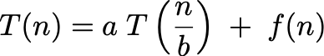
Master Theorem
Goal. Recipe for solving common divide-and-conquer recurrences: with T(0) = 0 and T(1) = Θ(1).
Terms.
a ≥ 1 is the number of subproblems.
b ≥ 2 is the factor by which the subproblem size decreases.
f (n) ≥ 0 is the work to divide and combine subproblems.
Recursion tree. [ assuming n is a power of b ]
a = branching factor.
a^{k} = number of subproblems at level k.
1 + log_{b} n levels.
n / b^{k} = size of subproblem at level k.

Slide 133
Run-time Analysis of Merge Sort
The time required to sort an array of size n > 1 is:
the time required to sort the first half,
the time required to sort the second half, and
the time required to merge the two lists
That is:
Solution: T(n) = Θ(n ln(n))

Slide 134
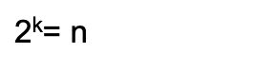
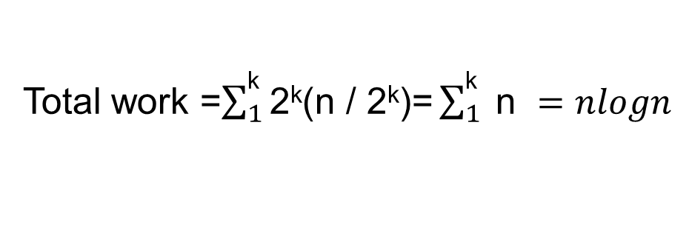
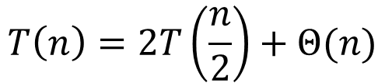

Recursion Tree for Merge Sort
Level
Problem #
Problem size
Work
0
1
n
n
1
2
(n/2)
2(n/2)
2
4
(n/4)
4(n/4)
. . .
. . .
. . .
. . .
. . .
k=log₂n
. . . . . .
$\text{2}\text{k}$= n
1
$$\text{2}\text{k}\text{(}\text{n}\text{ / 2}\text{k}\text{)}$$
$$T\left(n\right)=2T\left(\frac{n}{2}\right)+Θ(n)$$
Total work =$\sum_{1}^{\text{k}}{\text{2}\text{k}\text{(}\text{n}\text{ / 2}\text{k}\text{)}\text{=}\sum_{1}^{\text{k}}{ \text{n} }}=nlogn$

Slide 135
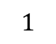
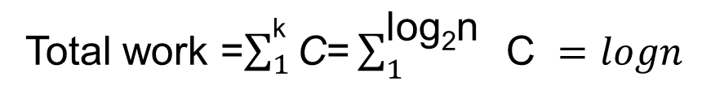
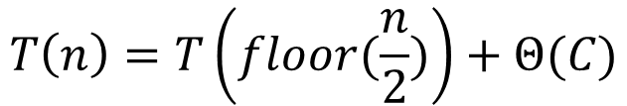
Recursion Tree for ?
Level
Problem #
Problem size
Work
0
1
n
C
1
1
(n/2)
C
2
1
(n/4)
C
. . .
. . .
. . .
. . .
. . .
k=log₂n
. . . . . .
$$1$$
1
C
$$T\left(n\right)=T\left(floor(\frac{n}{2})\right)+Θ(C)$$
Total work =$\sum_{1}^{\text{k}}{\text{C}\text{=}\sum_{1}^{\text{log}\text{2}\text{n} }{ \text{C} }}=logn$

Slide 136
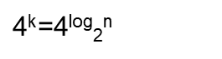
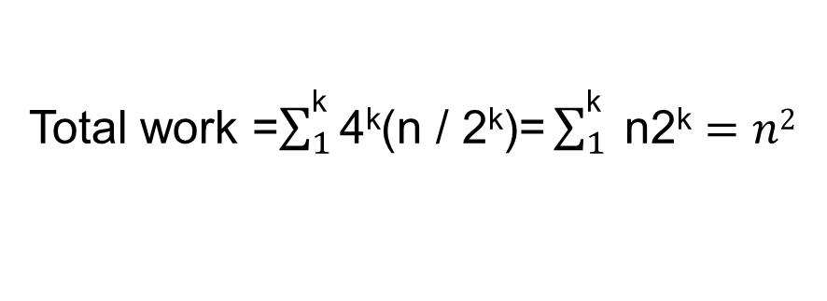
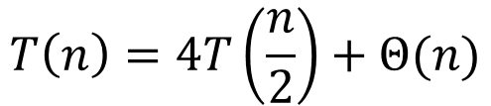

Recursion Tree for ?
Level
Problem #
Problem size
Work
0
1
n
n
1
4
(n/2)
4(n/2)
2
. . .
. . .
. . .
. . .
4²
(n/4)
4²(n/4)
4
4
4
4
. . .
. . .
. . .
. . .
. . .
k=log₂n
. . . . . .
$\text{4}\text{k}$=4^{log}₂^{n}
1
$$\text{4}\text{k}\text{(}\text{n}\text{ / 2}\text{k}\text{)}$$
$$T\left(n\right)=4T\left(\frac{n}{2}\right)+Θ(n)$$
Total work =$\sum_{1}^{\text{k}}{\text{4}\text{k}\text{(}\text{n}\text{ / 2}\text{k}\text{)}\text{=}\sum_{1}^{\text{k}}{ \text{n}\text{2}\text{k}}}=n2$
Notes:
multiply two n-bit integers

Slide 137
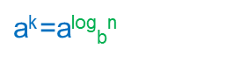
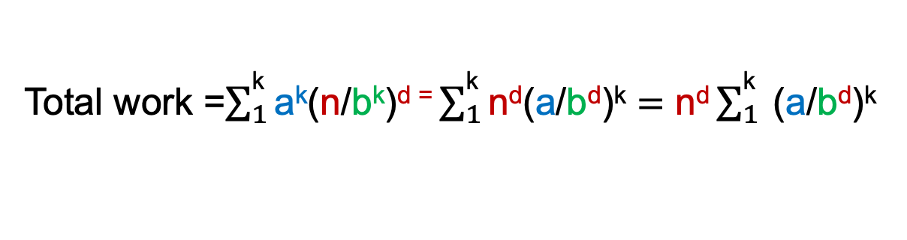
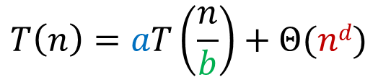
Master Theorem
Level
Problem #
Problem size
Work
0
1
n
n^{d}
1
a
(n/b)
a(n/b)^{d}
2
. . .
. . .
. . .
. . .
a²
(n/b²)
a²(n/b²) ^{d}
a
a
a
a
. . .
. . .
. . .
. . .
. . .
k=log_{b}n
. . . . . .
$\text{a}\text{k}$=a^{log}_{b}^{n}
1
a^{k}(n/b^{k}) ^{d}
$$T\left(n\right)=aT\left(\frac{n}{b}\right)+Θ(nd)$$
Total work =$\sum_{1}^{\text{k}}{\text{a}\text{k}\text{(}\text{n}\text{/}\text{b}\text{k}\text{)}\text{d}\text{ =}\sum_{1}^{\text{k}}{\text{n}\text{d}\text{(}\text{a}\text{/}\text{b}\text{d}\text{)}\text{k}}}=\text{n}\text{d}\sum_{1}^{\text{k}}{ \text{(}\text{a}\text{/}\text{b}\text{d}\text{)}\text{k}}$

Slide 138

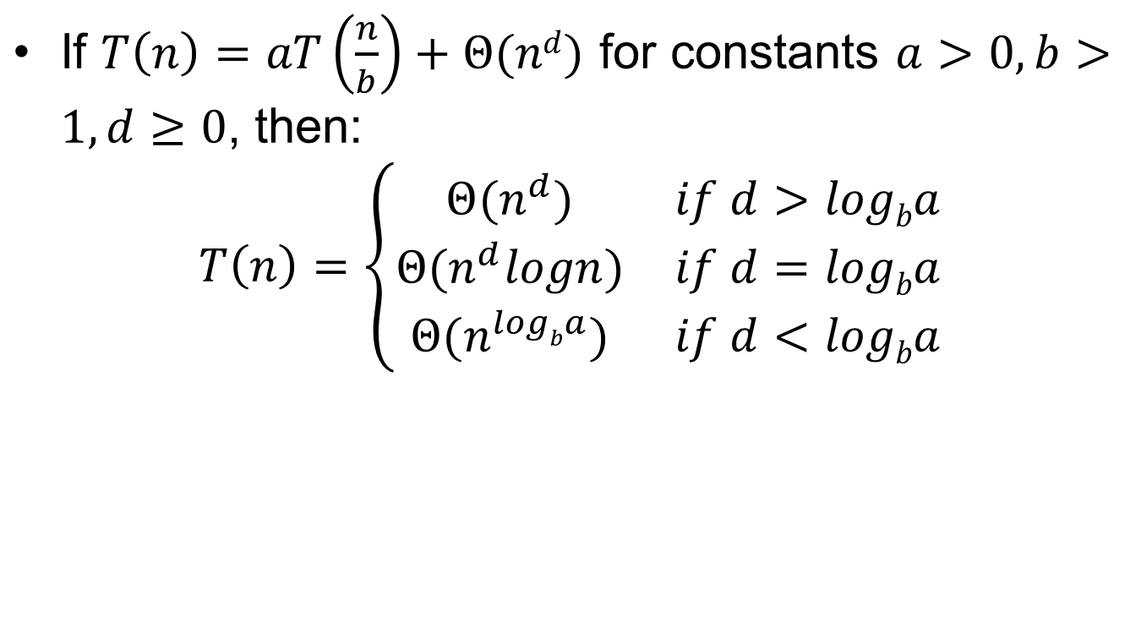
Master Theorem
If $T\left(n\right)=aT\left(\frac{n}{b}\right)+Θ(nd)$ for constants $a>0, b>1, d≥0$, then:
$$T\left(n\right)=\left\{\begin{matrix}Θ(n^{d}) & if d>logba \\ Θ(n^{d}logn) & if d=logba \\ Θ(n^{logba}) & if d<logba\end{matrix}\right.$$
I think we should remember it.

Slide 139
Master Theorem
If $T\left(n\right)=aT\left(\frac{n}{b}\right)+Θ(nd)$ for constants $a>0, b>1, d≥0$, then:
$$T\left(n\right)=\left\{\begin{matrix}Θ(n^{d}) & if d>logba \\ Θ(n^{d}logn) & if d=logba \\ Θ(n^{logba}) & if d<logba\end{matrix}\right.$$
I think we can understand it.

Slide 140
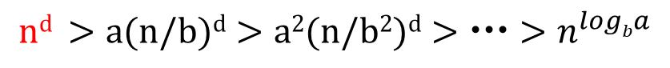
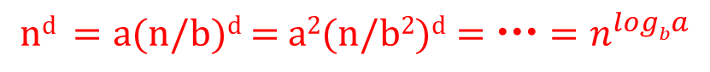
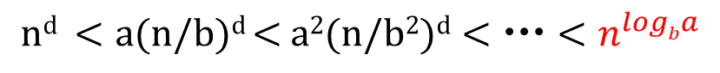
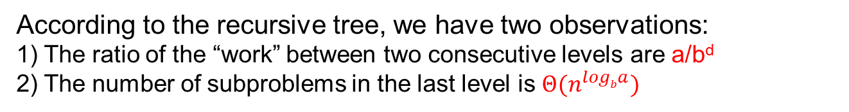
Master Theorem
If $T\left(n\right)=aT\left(\frac{n}{b}\right)+Θ(nd)$ for constants $a>0, b>1, d≥0$, then:
$$T\left(n\right)=\left\{\begin{matrix}Θ(n^{d}) & if d>logba \\ Θ(n^{d}logn) & if d=logba \\ Θ(n^{logba}) & if d<logba\end{matrix}\right.$$
According to the recursive tree, we have two observations:
1) The ratio of the “work” between two consecutive levels are a/b^{d}
2) The number of subproblems in the last level is $Θ(n^{logba})$
We have three cases in Master Theorem that correspond to:
Case 1:
Case 2:
Case 3:
$$\text{n}\text{d} >\text{a}\text{(}\text{n}\text{/}\text{b}\text{)}\text{d}>\text{a}\text{2}\text{(}\text{n}\text{/}\text{b}\text{2}\text{)}\text{d}>>n^{logba}$$
$$\text{n}\text{d} =\text{a}\text{(}\text{n}\text{/}\text{b}\text{)}\text{d}\text{ = }\text{a}\text{2}\text{(}\text{n}\text{/}\text{b}\text{2}\text{)}\text{d}==n^{logba}$$
$$\text{n}\text{d} <\text{a}\text{(}\text{n}\text{/}\text{b}\text{)}\text{d} \text{< }\text{a}\text{2}\text{(}\text{n}\text{/}\text{b}\text{2}\text{)}\text{d}<<n^{logba}$$

Slide 141
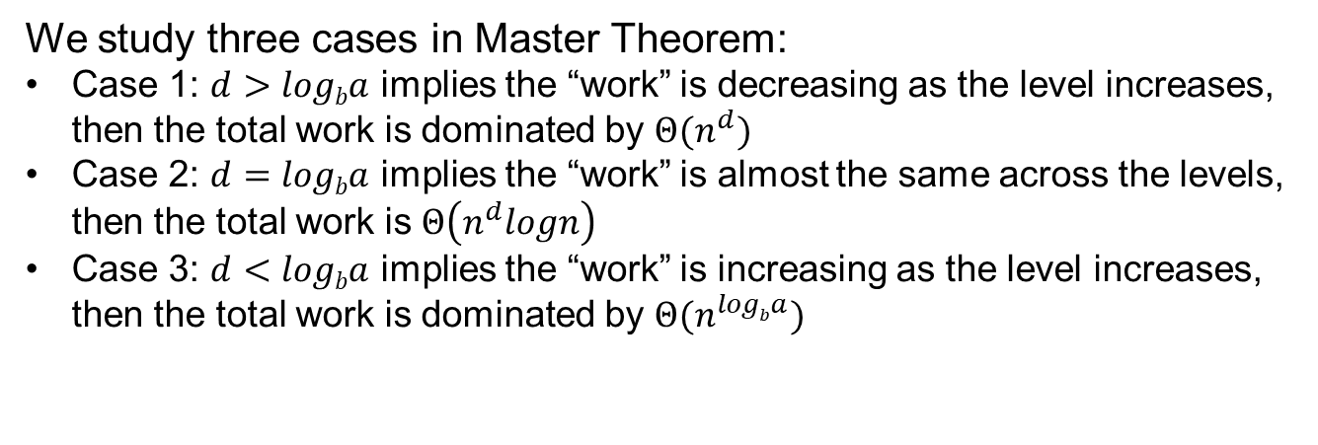
Master Theorem
If $T\left(n\right)=aT\left(\frac{n}{b}\right)+Θ(nd)$ for constants $a>0, b>1, d≥0$, then:
$$T\left(n\right)=\left\{\begin{matrix}Θ(n^{d}) & if d>logba \\ Θ(n^{d}logn) & if d=logba \\ Θ(n^{logba}) & if d<logba\end{matrix}\right.$$
We study three cases in Master Theorem:
Case 1: $d>logba$ implies the “work” is decreasing as the level increases, then the total work is dominated by $Θ(n^{d})$
Case 2: $d=logba$ implies the “work” is almost the same across the levels, then the total work is $Θ\left(n^{d}logn\right)$
Case 3: $d<logba$ implies the “work” is increasing as the level increases, then the total work is dominated by $Θ(n^{logba})$

Slide 142
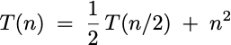
Master theorem does not apply
Gaps in master theorem.
Number of subproblems is not a constant.
Number of subproblems is less than 1.
No polynomial separation between f(n) and n^{logba}.
f(n) is not positive.
Regularity condition does not hold.

Slide 143
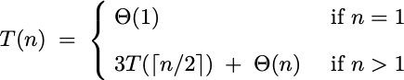
Question 1
Consider the following recurrence. Which case of the master theorem?
Case 1: T(n) = Θ(n^{log23}) = O(n^{1.585}).
Case 2: T(n) = Θ(n log n).
Case 3: T(n) = Θ(n).
Master theorem not applicable.

